Slide 1
Infinite series for complex variable
Da Zhou (周 达)
zhouda@xmu.edu.cn

Slide 2
Function of a complex variable

Slide 3
Function of a complex variable

Slide 4
How to plot a complex function?
https://samuelj.li/complex-function-plotter/#

Slide 5
Limit and continuity

Slide 6
Limit and continuity
Remarks:
Uniform continuity
Properties of continuous function on bounded and closed region

Slide 7
Differentiation

Slide 8
Differentiation
Surprisingly strong constraint!!

Slide 9
Differentiation

Slide 10
Cauchy-Riemann equations

Slide 11
Cauchy-Riemann equations

Slide 12
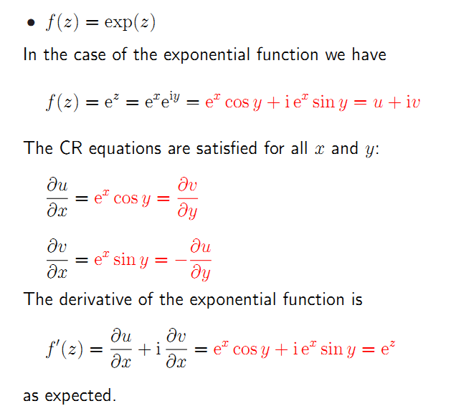
pp-134, 剑桥讲义

Slide 13


Analytic function

Slide 14
Differentiation rules

Slide 15
Examples

Slide 16
Examples
Multiple-valued functions require
special treatment:
f(z)=ln(z)
f(z)=zª (a is a real number)

Slide 18
Singular point
Many complex functions are analytic everywhere in the complex plane except at isolated points, which are called the singular points or singularities of the function.

Slide 19
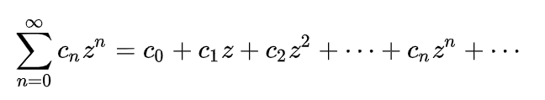
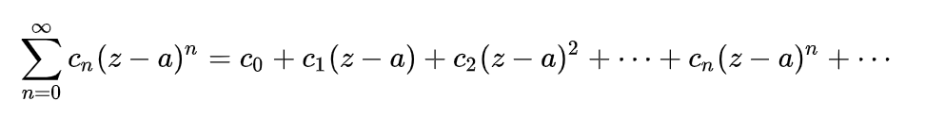
Power series of complex variable

Slide 20
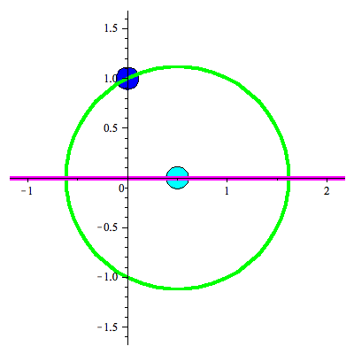
Circle of convergence
Determination of the radius of convergence
The radius of convergence of the Taylor series of a function about z=z₀ is equal to the distance of the nearest singular point of the function from z₀.

Slide 21
Taylor series for an analytic function
The derivative of an analytic function is also analytic.
Hence, all derivatives of an analytic function are also analytic.

Slide 22
Taylor series for an analytic function

Slide 23
Real analytic function
f(x) is said to be analytic at x₀ if it has Taylor series at x_{0.}

Slide 24
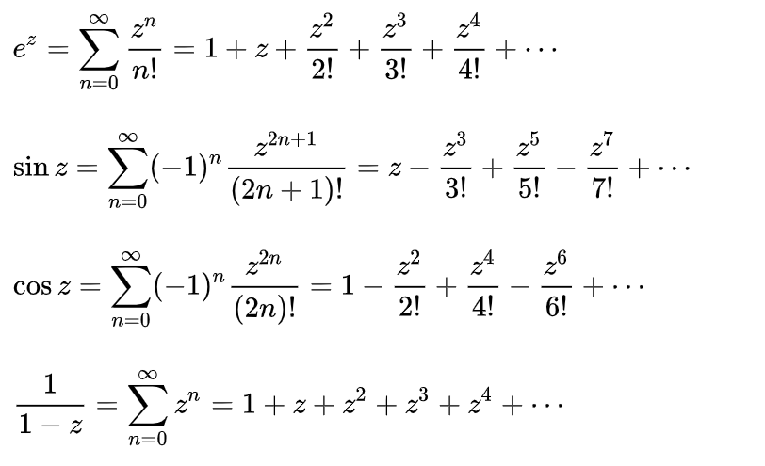
Taylor series in common use

Slide 25
Singular point
Many complex functions are analytic everywhere in the complex plane except at isolated points, which are called the singular points or singularities of the function.

Slide 26
Classification of singular points
Movable singularities, e.g.
Poles, .e.g.
Essential singularities, e.g.

Slide 27
Movable singularities

Slide 28
The order of Poles:
A simple pole is a pole of order 1. A double pole is one of order 2, etc

Slide 29
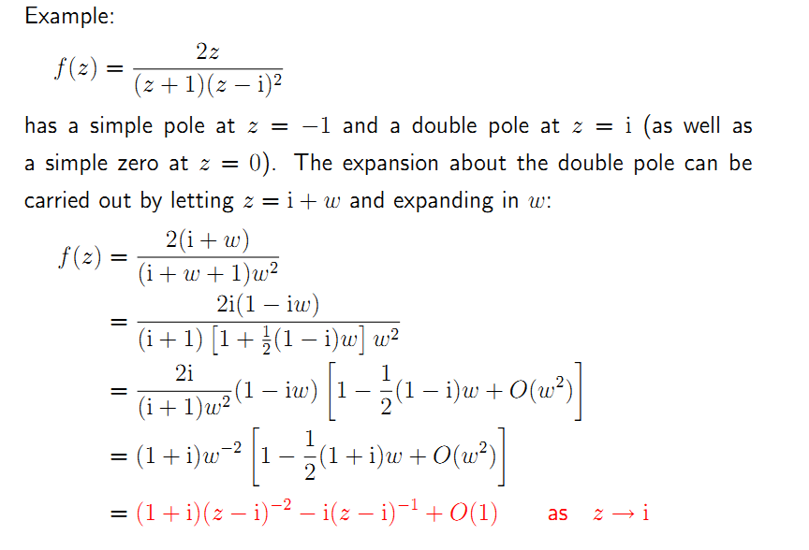
pp-139, 剑桥讲义

Slide 30
Essential singularities

Slide 31
Essential singularities

Slide 32
Laurent series in annulus

Slide 35
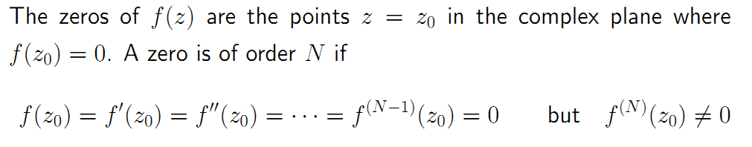
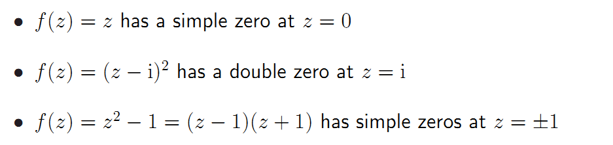
Zeros

Slide 36
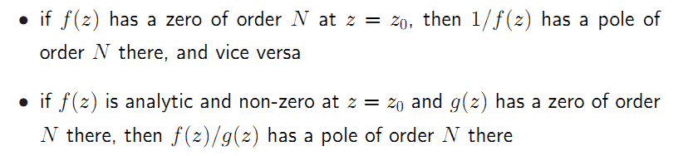
Zero and Pole

Slide 37
Summary
The existence of derivative is a surprisingly strong condition for complex functions
- CR equation
- Cauchy Theorem
- Cauchy formula
- Analytic (power series)
Laurent series is a generalization of power series.

